Slide 1
Radial dependence of surface brightness in NGC5888
Kaylee Klapmeyer
Rolf Jansen
Notes:
My name is Kaylee Klapmeyer, I worked with my mentor Rolf Jansen on the radial dependence of surface brightness in the test galaxy NGC5888.

Slide 2
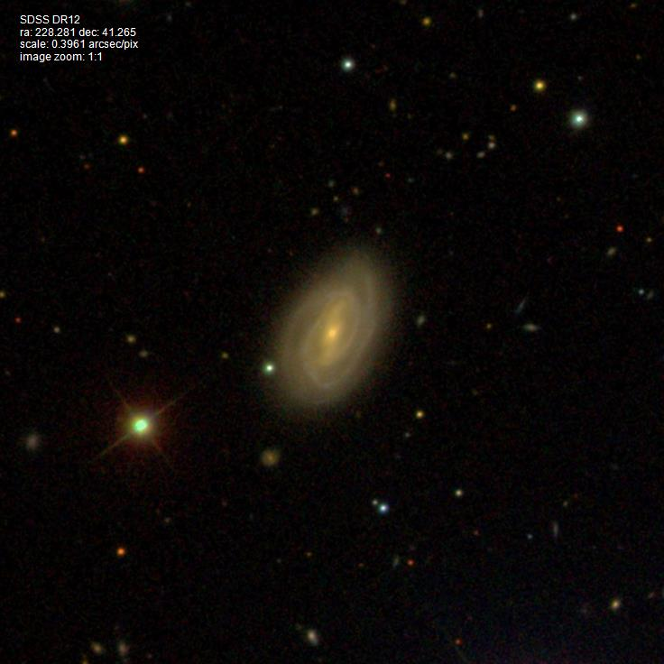
ngc5888
This project aims to analyze trends, with radius, of surface brightness and color within relatively nearby galaxies and attempts to answer whether or not galaxies are more opaque in their central region than in their outskirts
Zahid et al. (2013)
Result that no significant dependence of extinction on the radius was detected that seems to conflict with typical findings
Work done includes data in these filters:
B and R (0.44 and 0.65 micron; SAO48”, Jansen et al. 2000)
J, H, and Ks (1.25, 1.65, and 2.17 micron; 2MASS, Jarrett et al. 2002)
3.4 and 4.6 micron (WISE, Wright et al. 2010)
SDSS gri color composite of galaxy NGC5888
Notes:
The goal of the project was to analyze trends with radius of surface brightness and color within relatively nearby galaxies and attempt to answer whether or not galaxies are more opaque in their central region than the outskirts.
The project idea came from a result in a recent paper by Zahid et al. that claimed there was no significant dependence of extinction on the radius, which was unusual.
The work done includes data in B and R, J, H, and Ks, and 3.4 and 4.6 micron filters.
The galaxy NGC5888 was used as a test case and is shown in the image on the right.

Slide 3
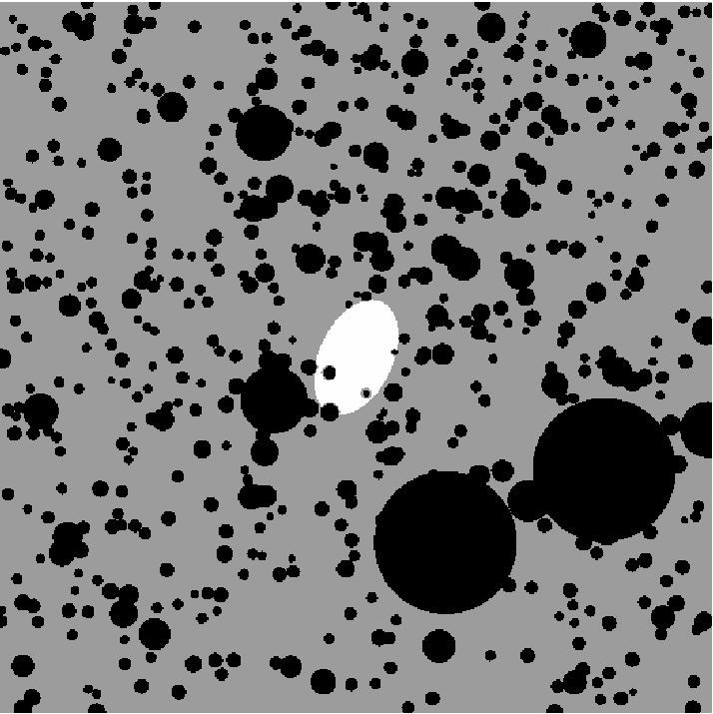
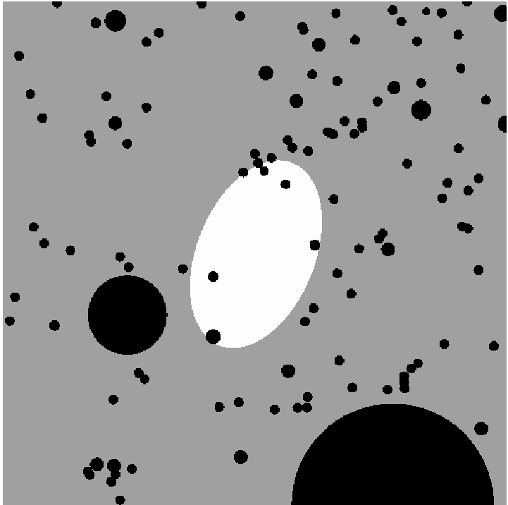
processes: mask
Created a mask for NGC5888
SAOImage ds9 used to generate regions files
mkmask compiled in Fortran
Written by Rolf Jansen
Flagged pixels belonging to any of the three classes:
White: galaxy given value of 1
Grey: background given value of 0
Black: light sources given value of -1
3.4 micron mask
R mask
Notes:
The first step was to create a mask and flag all of the pixels that weren’t from the galaxy.
ds9 was used to generate the regions files.
And mkmask was a script used that was written by Rolf and compiled in Fortran. It is also available free on his website.
The 3.4 micron mask is shown on the left and the R band mask on the right.
The white coloring represents the galaxy, while the gray represents the background and the black is other light sources.

Slide 4
smoothing
Smoothed the profiles in each of the filters to the resolution of the WISE 4.6 micron image (7.268 pixels) using a filter dependent Gaussian kernel
Resolution of B, R, J, H, Ks, and 3.4mu images respectively:
2.2154 pix, 2.0745 pix, 1.098 pix, 1.075 pix, 1.113 pix, and 6.520 pix
Converted magnitudes from the Vega system to the AB (physical) system
$\text{M}\text{AB}\text{= }\text{Mvega}+∆\text{M}$
$∆\text{M}$ values for B, R, J, H, Ks, and 3.4mu respectively:
0.09, 0.21, 0.91, 1.39, 1.85, 2.699, 3.339
Notes:
Next we smoothed the profiles in each of the filters to match the resolution of the 4.6 micron image of 7.268 pixels.
We did this using a Gaussian kernel.
Shown below are each of the filters along with their respective resolutions.
The magnitudes then had to be converted from Vega to AB, which is the standard system.
I used delta M values for each filter to convert them, which are also shown below.

Slide 5
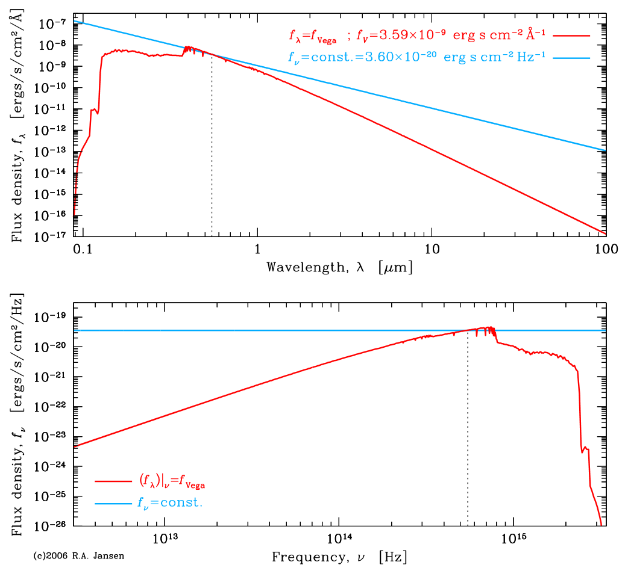
smoothing
Comparison of the spectrum of Vega and a spectrum that is flat in f_{𝛎}
The former defines the Vega, the latter the AB magnitude system
Source: R.A. Jansen
Notes:
Here is a visual representation of the spectrum of Vega and one that is flat in f_nu.
The top shows the Vega system and the bottom graph depicts the AB magnitude system

Slide 6
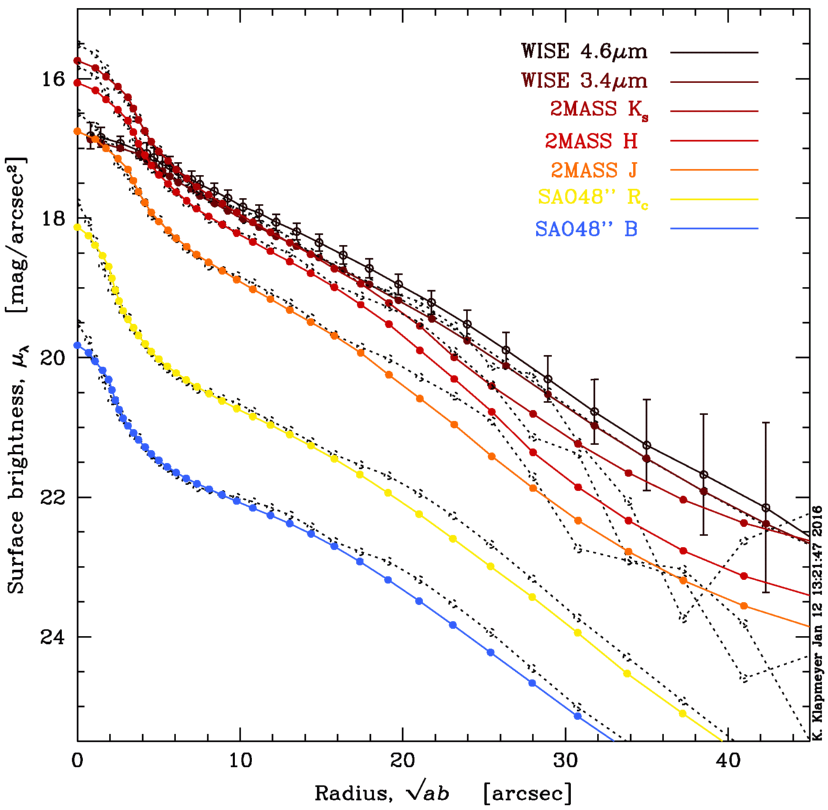
Radial profiles of surface brightness
Constructed radial profiles of surface brightness in each filter
galprof.pro –IDL routine written by Rolf Jansen available on website
Dotted curves represent the surface brightness profiles prior to smoothing
Notes:
Next was to construct the radial surface brightness profiles in each of the seven filters.
I used an IDL routine written by Rolf called galprof.pro
The dotted curves alongside the colored ones represent the curve prior to smoothing.
The filters listed in the upper right-hand corner match with the curve of the same color.

Slide 7
Radial profiles of surface brightness
Coding done in SuperMongo
Measured azimuthally averaged radial surface brightness profiles in elliptical annuli
Example piece of code (3.4 micron)
rfile 167.NGC5888_3.4.prof
set xx = -5, 5, 1
set kk = sqrt ( (7.268*1.375)**2 )/1.375
set gg = gauss(xx, 0 (kk/2.354))
smooth2 mu mu_sm gg
Notes:
The coding for this plot was done in SuperMongo, and an example piece is shown here.
**We measured azimuthally averaged radial surface brightness profiles in elliptical annuli. **
The code shown was written in a standard text editor, kwrite, and was used to produce the 3.4 micron profile.
It reads in the 3.4 profile and then smooths it to the 4.6 micron resolution with a Guassian kernel.

Slide 8
RADIAL PROFILES of surface brightness
Finer details in the SDSS gri image lost
As expected, the radial profile of surface brightness shows decreasing surface brightness at increasing galactocentric distances
In the SED the surface brightness in magnitude units decreases almost linearly with increasing radius
SDSS gri color composite of galaxy NGC5888
Notes:
Now, since the profiles were smoothed, the fine details seen in the image of the galaxy on the left will have been lost.
As expected, the radial profiles show decreasing surface brightness at increasing galactocentric distances.
And as you will see on the next slide, the surface brightness in magnitude decreases almost linearly with increasing radius on the SED

Slide 9
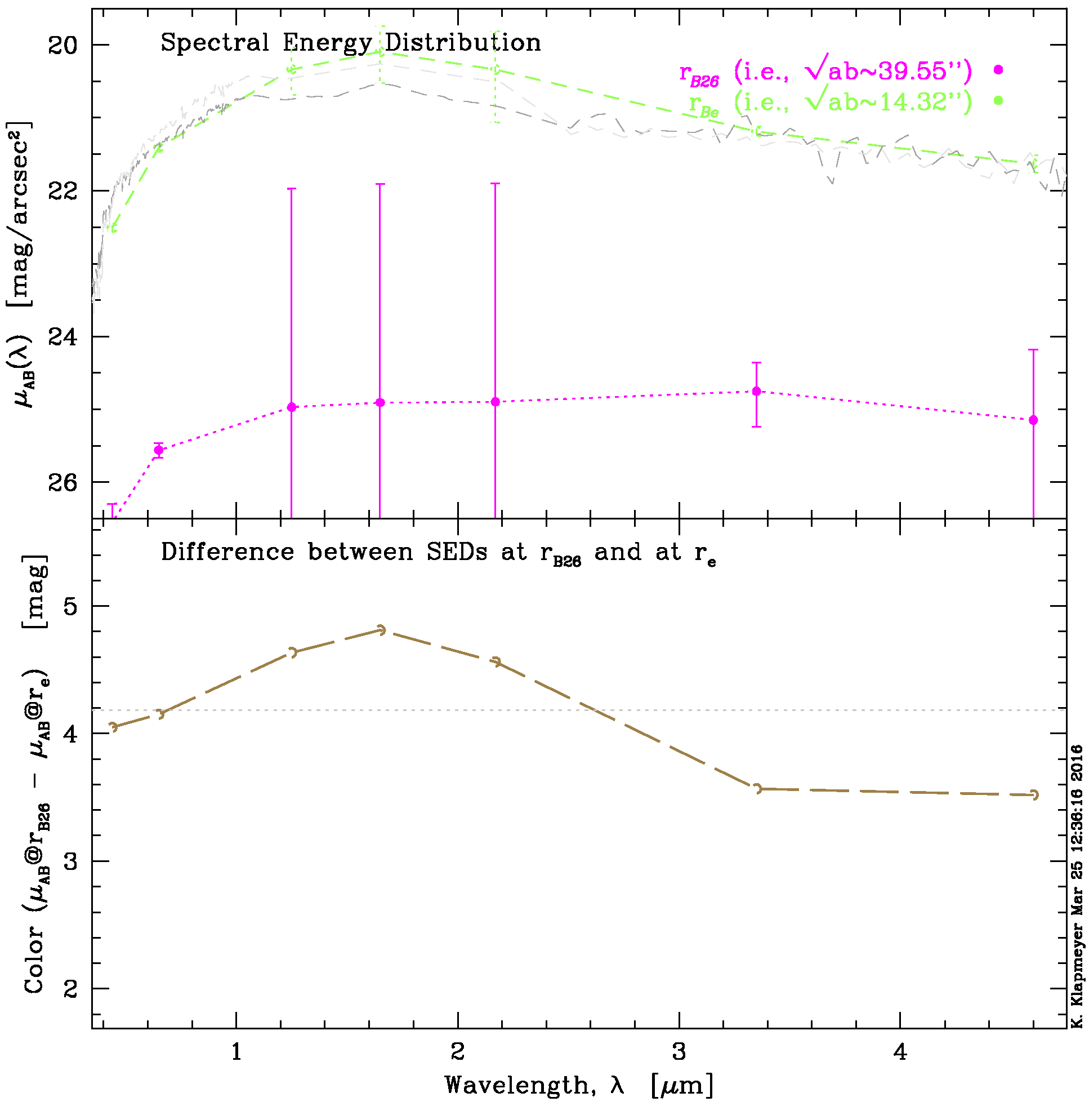
Spectral energy distribution
Plotted spectral energy distribution at two radii
r_{B26} =39.55 and r_{Be} =14.32
Flux densities at those radii were determined through interpolation in the surface brightness profiles
Notes:
The SED shown on the right is the spectral energy distribution at two different radii.
The flux densities at those radii were found through interpolation in the previous surface brightness profiles.

Slide 10
Spectral energy distribution
Result if the stellar populations at the half-light radius and at the B₂₆ radius were identical indicated by the dotted line
Change in color as a function of wavelength means either or all of average Age (t), Metallicity (Z), and Extinction (A_{V}) must vary with radius
Notes:
If the stellar populations were the same at both radii then the difference would only show an offset in the bottom panel, which is shown by the dotted line.
But since we do see a change in color as a function of wavelength, then either one or all of the age, metallicity, and extinction must vary with radius.

Slide 11
Future work
The goal is to understand the radial dependence of dust extinction as well as properties of stellar populations, by comparison of the measured colors with simple and composite stellar population synthesis models (e.g., Kim et al. 2016)
This work on NGC5888 will serve as a test case for the analysis of a larger sample of relatively nearby galaxies drawn from the Nearby Field Galaxy Survey (Jansen et al. 2000)
Notes:
The goal of this research is to understand the radial dependence of dust extinction and properties of stellar populations,
Using comparison of the measured colors with stellar population synthesis models.
So this work on NGC5888 will serve as a test case for the analysis of a larger sample.

Slide 12
Acknowledgements & cited papers
I would like to thank my mentor Rolf Jansen for his support and guidance throughout my project and ASU/NASA Space Grant.
Jansen, R.A., et al. 2000, ApJS 126, 271-397
Jarrett, T.H. et al. 2003, AJ 125, 525-554
Kim, D., et al. 2016, AJ (submitted)
Wright, E.L., et al. 2010, AJ 140, 1868-1881
Zahid, H.J., et al. 2013, ApJS 763.2, 92
Rolf Jansen’s website: public.asu.edu/~rjansen
Notes:
And finally, I’d like to thank Rolf for his help throughout my project and ASU/NASA Space Grant.
Below is Rolf’s website, where you can find the mkmask and galprof.pro that are available free.
Any questions?

